Slide 1
PROJECT TITLE : BLAZE DEMO
BATCH NO: 7426
BY
POTTRI SELVAM V

Slide 2
AGENDA
MANUAL TESTING
FRS
TEST CASE
BUG REPORT
AUTOMATION TESTING
ECLLIPSE IDE VERSION
AUTOMATION TOOLS-SELENIUM WEB DRIVER
PLUG IN - CHROPATH

Slide 3
CONCEPT IMPLEMENTED
LOCATORS
XPATH
COLLECTIONS

Slide 4
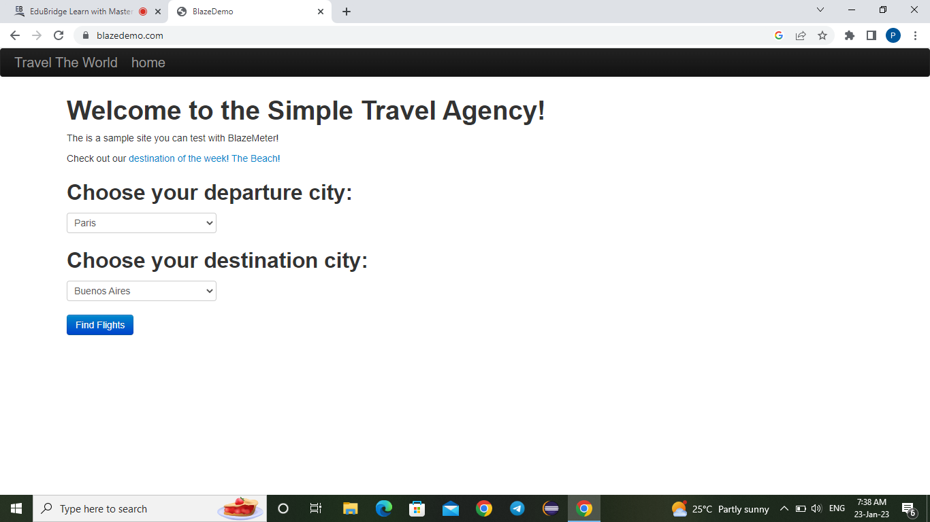

Slide 5
MANUAL TESTING
FRS
An FRS or functional requirement specification is the document that describes all the functions that software or product has to perform. In fact, it's a step-by-step sequence of all operations required to develop a product from very start to end.
Test case
A test case is a singular set of actions or instructions for a tester to perform that validates a specific aspect of a product or application functionality. If the test fails, the result might be a software defect that the organization can triage

Slide 6
Bug report
A Bug Report in Software Testing is a detailed document about bugs found in the software application. Bug report contains each detail about bugs like description, date when bug was found, name of tester who found it, name of developer who fixed it

Slide 7
AUTOMATION TESTING Automated testing is a process that validates if software is functioning appropriately and meeting requirements before it is released into production. This software testing method uses scripted sequences that are executed by testing tools. ECLLIPSE IDE VERSION Eclipse is a free, Java-based development platform known for its plugins that allow developers to develop and test code written in other programming languages. JDK 8 The Java Platform, Standard Edition 8 Development Kit (JDK 8) is a feature release of the Java SE platform. It contains new features and enhancements in many functional areas.

Slide 8
AUTOMATION TOOLS SELENIUM WEBDRIVER Selenium WebDriver is a web framework that permits you to execute cross-browser tests. This tool is used for automating web-based application testing to verify that it performs expectedly. Selenium WebDriver allows you to choose a programming language to create test scripts. Selenium WebDriver is used to automate web application testing to verify that it works as expected. It supports many browsers such as Firefox, Chrome, IE, and Safari. However, using the Selenium WebDriver, we can automate testing for web applications only.

Slide 9
PLUG IN – CHROPATH ChroPath is considered as a development tool to edit, inspect and generate XPath and CSS Selectors. On using ChroPath, it makes us easy to write, edit, extract and evaluate XPath and CSS queries on any webpage and saves at least 40–50% manual effort in automation script writing. ChroPath helps to generate and validate selectors like relative xpath, cssSelector etc with iframe support. Very Important for Firefox 70 users: By default you won't be able to type / and ' in ChroPath selector box because of below preference, so please change it.

Slide 10
CONCEPTS USED LOCATORS Locators are basically the HTML attributes of a web element. They help identify unique web elements on a page and command testing frameworks, such as Selenium WebDriver, to perform the action on those elements. Locators are also known as selectorS XPATH XPath is a Selenium technique to navigate through a page's HTML structure. It enables testers to navigate through any document's XML structure, which can be used on both HTML and XML documents

Slide 11
COLLECTIONS A collection is an object that represents a group of individual objects represented as a single unit. Collection is a dynamic array where we can add elements and reduce elements

Slide 12
VALIDATIONS 1. ChEcking title of the page 2. purchasing a ticket through blazedemo 3. total number of hyperlinks and images print in console

Slide 13
Thank you

